Slide 1
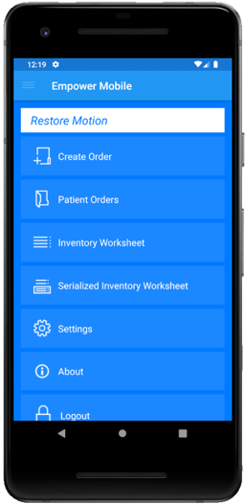
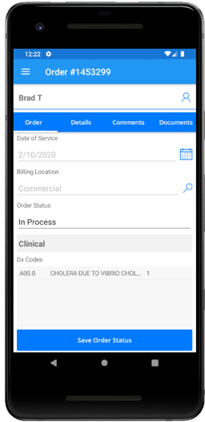
Ossur – Mobile Inventory Application
Business Need
Following the revitalization of Ossur’s web application, the company sought to extend its product offering with mobile apps for iOS and Android to remain competitive. The highest-value workflow identified for this expansion was Inventory Management. A critical requirement was offline functionality so that field users could continue working outside of cell service, with seamless syncing once connectivity was restored.
Outcomes
Designed and implemented a cross-platform mobile app in Xamarin Forms for iOS and Android
Delivered an intuitive mobile experience that adapts between online and offline states
Reused the existing backend to ensure consistency and reduce implementation cost
Built a reusable offline framework for caching, data capture, reconciliation, and conflict resolution
Enabled field users to manage inventory reliably in any environment

